Slide 1
Reading is a great way to take your mind off things, relax and at the same time improve your vocabulary…win/win!
Select a book you like the look of and click…its that simple.
Welcome to SPRS Virtual Library
Make sure that the Power point is in present so that you can access the books.
Step inside and have a look…

Slide 2
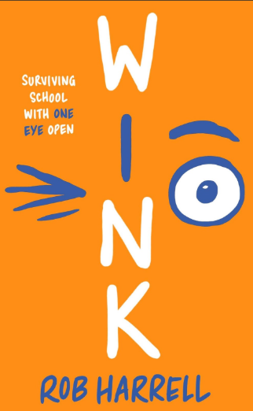
Spring Term
Recommended Book
Ross Molloy just wants to be normal. He doesn't want to lose his hair, or wear a weird hat, or deal with the disappearing friends who don't know what to say to 'the cancer kid'. But with his recent diagnosis of a rare eye cancer, simply blending in is no longer an option. Ross - and his friends and his family - all need to work out how to deal with this devastating challenge that life has thrown down.
Based on Rob Harrell's own real life experience of eye cancer, and including amazing comic-strip artwork, this poignant and authentic novel is unforgettable, hilarious and uplifting.
Audio Book - Bing Videos

Slide 3
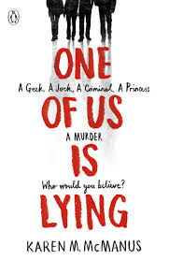
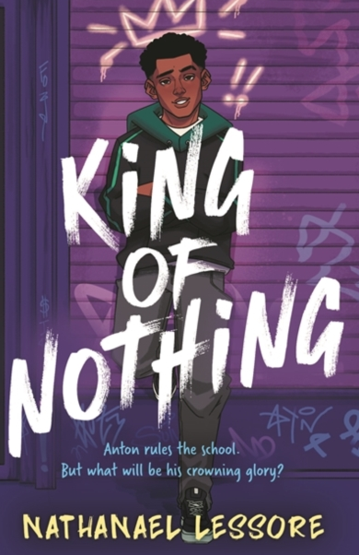
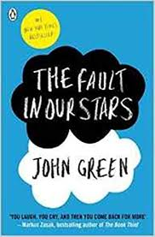
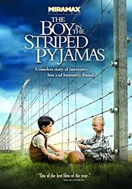
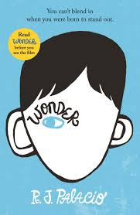
Looking for a new book? Check out these.
Check out these two and, the recent BBC adaptations on BBC iplayer.
Warning!!!
Ugly Cry Alert

Slide 4
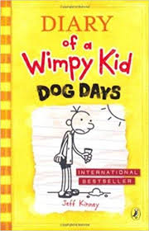
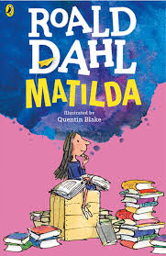
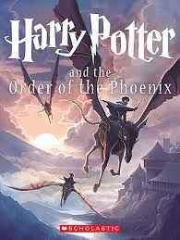
To read any of these books simply click on the picture.
Get comfy and enjoy!

Slide 5
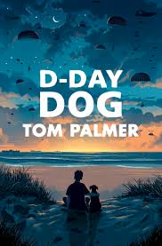
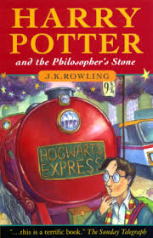
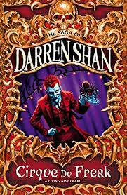
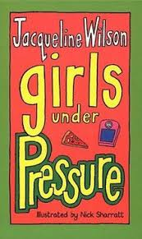
If you fancy listening to a book why not try audiobooks:
Click on a book to hear it read aloud.

Slide 6
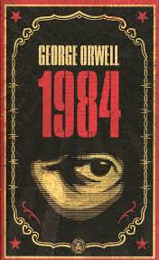
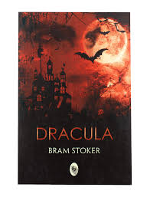
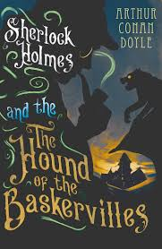
Classics
The only thing in the world that matters to Mrs Bennett, is marrying all five of her daughters to rich, landed gentlemen. So when two wealthy young gentlemen move to town, she vows that at least one of her daughters will marry into their fortunes.
Jane and Elizabeth, her eldest daughters, soon discover that love is rarely straightforward and is often surprising. Because, surely that sullen, quiet, mysterious Mr Darcy can't be more than he seems . . . can he?
1984 is a dystopian novella by George Orwell published in 1949, which follows the life of Winston Smith, a low ranking member of 'the Party', who is frustrated by the omnipresent eyes of the party, and its ominous ruler Big Brother. ‘
Big Brother' controls every aspect of people's lives.
Big Brother is watching you!

Slide 7
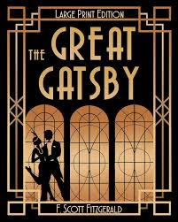
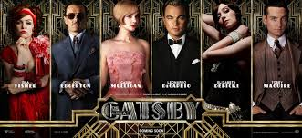
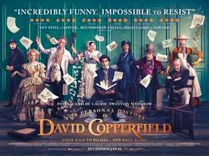
Feeling cultured? Why not try a classic and compare it to the film adaptation?
Set in Jazz Age New York, the novel tells the tragic story of Jay Gatsby, a self-made millionaire, and his pursuit of Daisy Buchanan, a wealthy young woman whom he loved in his youth.
The story of a young man's adventures on his journey from an unhappy childhood to the discovery of his vocation as a novelist. Among the gloriously vivid cast of characters he encounters are his tyrannical stepfather, Mr Murdstone; his brilliant but unworthy school-friend Steerforth; his formidable aunt, Betsey Trotwood; and the eternally humble yet treacherous Uriah Heep.
Beautiful, clever, rich-and single-Emma Woodhouse is perfectly content with her life and sees no need for either love or marriage. Nothing, however, delights her more than interfering in the romantic lives of others. But when she ignores the warnings of her good friend Mr. Knightley and attempts to arrange a suitable match for her protégée Harriet Smith, her carefully laid plans soon unravel and have consequences that she never expected.
Read the book or watch the film – click which one you prefer or do both!

